Slide 1
UI Design
Website Landing Page

Slide 2


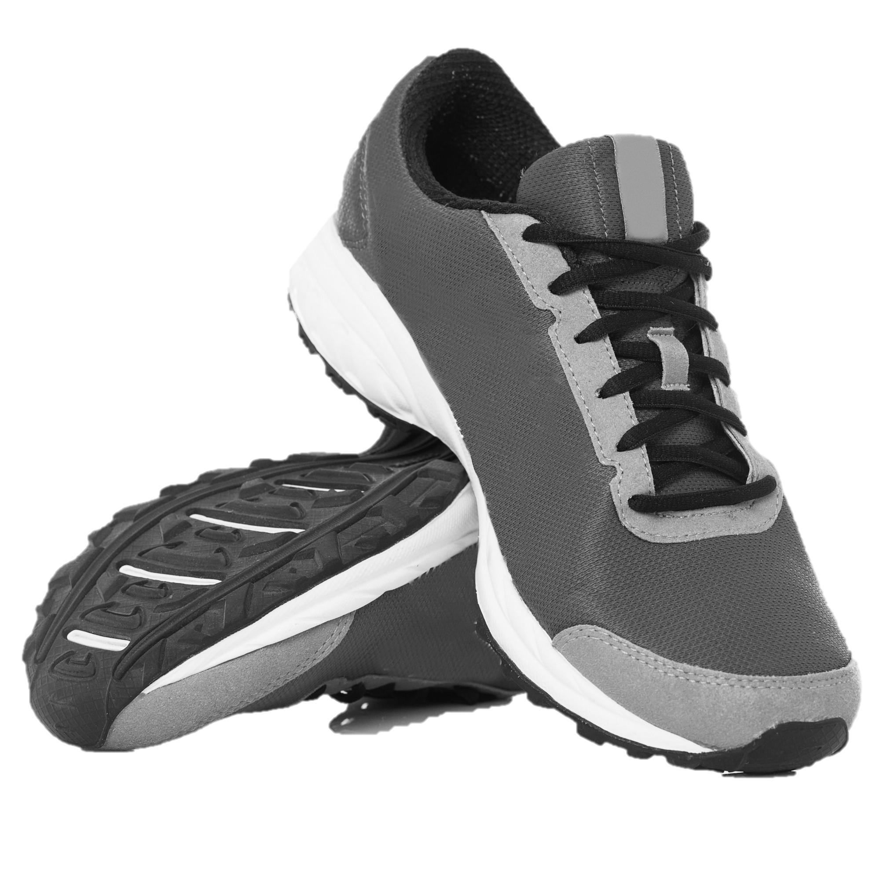

HOME
PRODUCT
CONTACT
ABOUT
SHOP NAME
Get Ready to Create
Your Own Way
Far far away, behind the word mountains, far from the countries Vokalia and Consonantia, there live the blind texts. It is a paradisematic country, in which roasted parts of sentences fly into your mouth.
BUY NOW
DARK GRAY
$350

